Slide 1
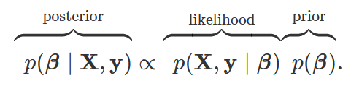
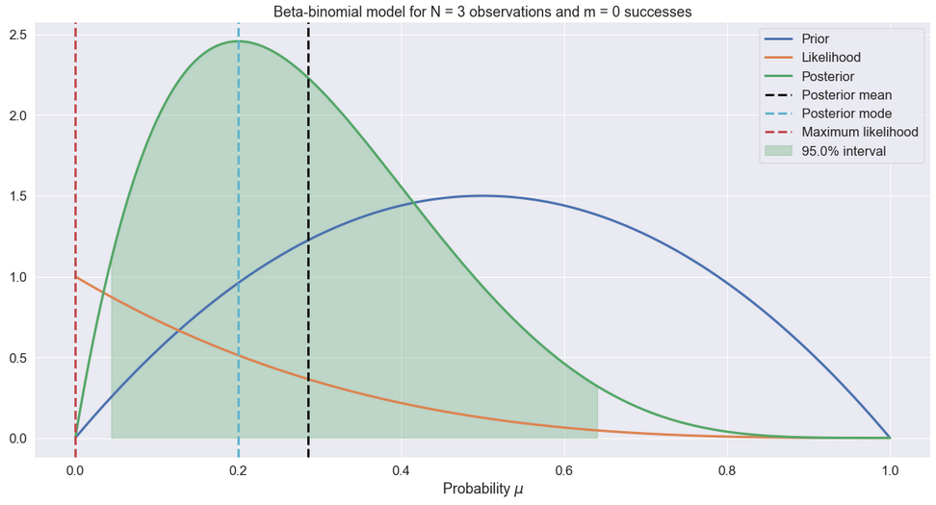
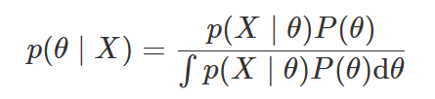
Bayesian Inference
Bayes Theorem:
Point Estimates | Exact Inference | Approximate Inference
Maximum A Posteriori | Conjugacy | Laplace
 |  | Monte Carlo
 |  | Variational Inference

Slide 2
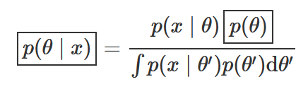
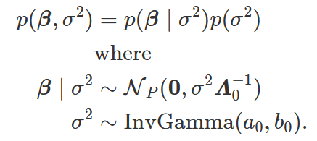
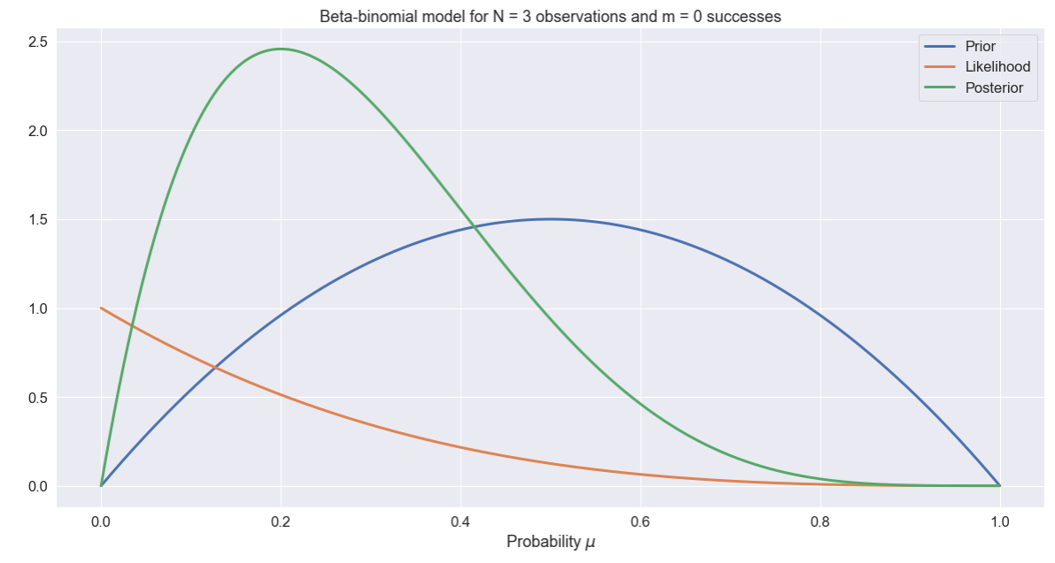
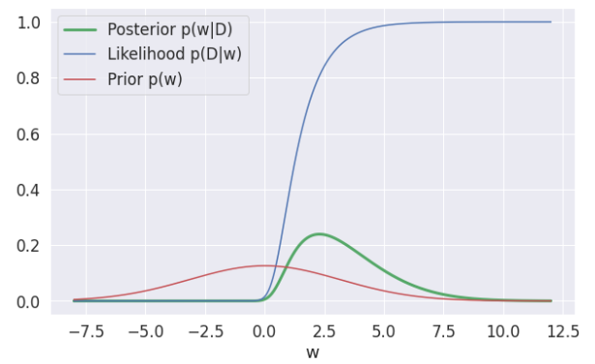
Conjugacy
Conjugacy is per variable.
Example - Normal-inverse-gamma:
Conjugate
Not Conjugate

Slide 3
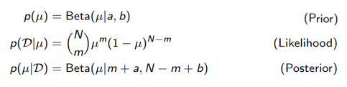
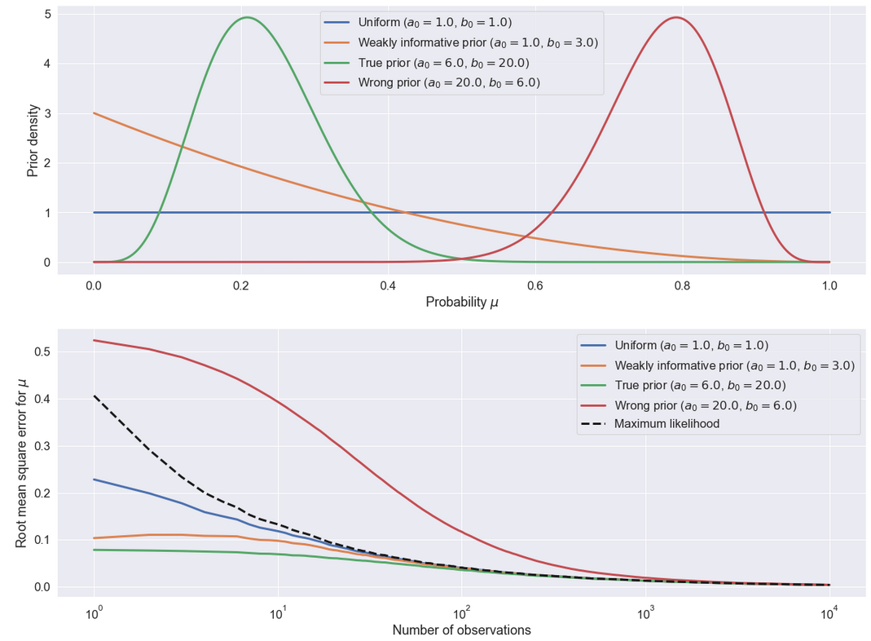
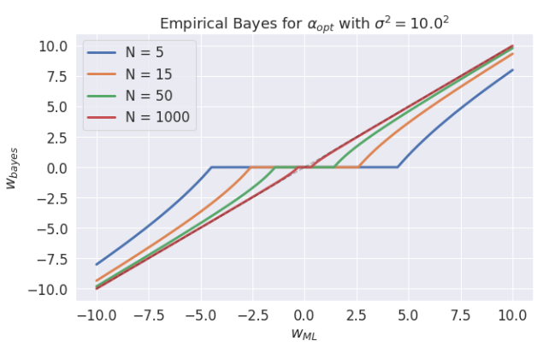
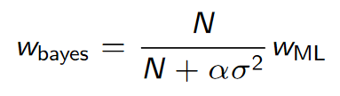
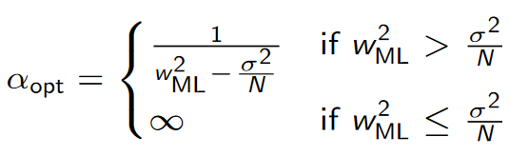
The Beta-Binomial Model
Bayesian framework places naturally regularization on the modelling. It is called shrinkage
All converges to the likelihood

